Slide 1
The Impact of EU-THMPD to TCM Sector in the UK After April 2011
By Hui Jun Shen
President
The Association of Traditional Chinese Medicine UK
At
Herbal Medicine Regulation Forum
King’s Fund, London
16th September 2010

Slide 2
Key Facts – three phases
Herbals Directive (EU’s THMPD)
  European Traditional Herbal Medicinal Products Directive 2004/24/EC amending Directive 2001/83/EC
  in force in April 2004
THR (UK’s MHRA)
  Traditional Herbal Products Registration Scheme
  Became available October 2005
Herbals Directive
  Full enforcement in April 2011

Slide 3
October 2005
April 2004
April 2011
Medicines Act 1968 | THMPD: 7 year transitional period starts | Herbal Medicinal Products Registration Scheme (THR) | THMPD Full Implement
Section 12(2) | Section 12(2) | Section 12(2) (Transitional Protection) and THR/MA | No more Section 12(2) THR/MA only
OK to Unlicensed HM products | OK to Unlicensed HM products | Still OK to Unlicensed HM products | Not OK any more to Unlicensed HM products

Slide 4
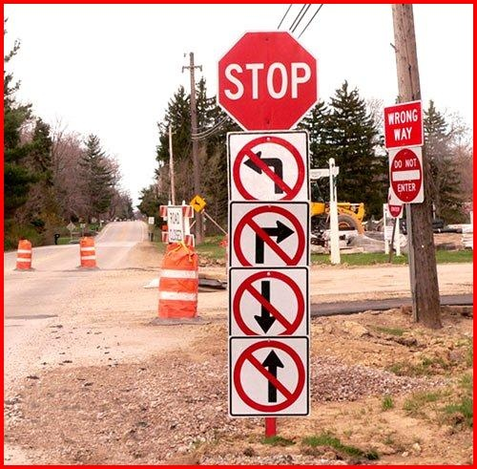


Stop to unlicensed/unregistered HM products
UK HM Market after April 2011
MHRA
Go to THR/MA products

Slide 5
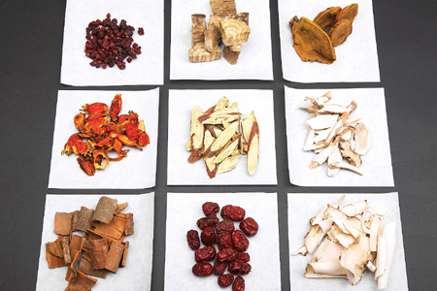
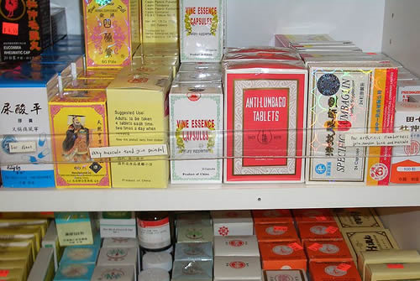
EU Directive and UK Medicines Act 1968
Section 12(1) still effective
Loose herbs: still OK
Self-made herbal products: still OK
Section 12(2) is replaced by EU Directive
Industrially manufactured herbal products: not OK

Slide 6
Section 12 of Medicines Act 1968
Exemptions in respect of herbal remedies
(1)The restrictions imposed by sections 7 and 8 of this Act do not apply to the sale, supply, manufacture or assembly of any herbal remedy in the course of a business where—
(a) the remedy is manufactured or assembled on premises of which the person carrying on the business is the occupier and which he is able to close so as to exclude the public, and
(b) the person carrying on the business sells or supplies the remedy for administration to a particular person after being requested by or on behalf of that person and in that person’s presence to use his own judgment as to the treatment required.
(2)Those restrictions also do not apply to the sale, supply, manufacture or assembly of any herbal remedy where the process to which the plant or plants are subjected in producing the remedy consists only of drying, crushing or comminuting, and the remedy is, or is to be, sold or supplied—
(a)under a designation which only specifies the plant or plants and the process and does not apply any other name to the remedy, and
(b)without any written recommendation (whether by means of a labelled container or package or a leaflet or in any other way) as to the use of the remedy.

Slide 7


Where We Are – according to MHRA
THR has been active since October 2005.
Over 150 applications, 69 granted THR products so far
Clear process available: companies provide outline information about the product and MHRA can provide advice.
However, no CHM products granted THR, even number of applications is very low.
Deadlock:
  THR is on offer, but not for CHM.
A big why

Slide 8

Why no CHM can achieve THR?
----According to MHRA
Issues with TCMs and the THR scheme are well known
Use ingredients outside scope of the THR scheme;
Indications are stronger than permitted, not based on proven efficacy;
Not reach the required period of EU traditional use;
Challenge in quality standards for more complex products.
A big issue:
quality check on each ingredient, more difficult and costly to multiple-ingredient products

Slide 9
Any Solutions?
Can THR be simplified for multiple-ingredient products?
  Without compromising quality and safety
Can any changes be made to the Directive?
  Although not imminent, but possible or not?
  Not to lower quality standards

Slide 10
Any Alternative?
Article 5.1 of the Directive 2001/83/EC
Allowing commissioning of unlicensed herbal products by “authorised healthcare professionals” to meet patient needs.
Practitioners regulation is the only way to allow us the status of “authorised healthcare professionals”.
If no statutory regulation, Art 5.1 is meaningless.

Slide 11
Updates from MHRA
August letter to HM traders:
After April 2011, all herbal medicinal products placed on the market in the UK must be licensed or THR registered.
manufacturers, importers and wholesalers will not be able to sell, supply or distribute any unlicensed or unregistered products after 30th April 2011.
No need for retailers to withdraw products after April 2011. Retail is allowed until the end of shelf life of the products.
Retailers must provide evidence on request that the products are ordered prior to April 2011. No more wholesale orders from retailers are allowed after April 2011.
Practitioner remedies made up for individual customers using Section 12(1) of Medicines Act will not be affected.

Slide 12
Guidance on Transitional arrangements for the Directive on traditional herbal medicinal products (Directive 2004/24/EC, amending Directive 2001/83/EC) http://www.mhra.gov.uk/Howweregulate/Medicines/Herbalmedicines/PlacingaherbalmedicineontheUKmarket/index.htm
MHRA, August 2010
On 30 April 2011 transitional protection under the Directive on traditional herbal medicinal products (Directive 2004/24/EC) expires.
This means that the “herbal exemption” from licensing under Section 12(2) of the Medicines Act 1968 will not longer be available.

Slide 13
MHRA Guidance: Provisions of the Directive on Traditional Herbal Medicinal Products that determine dates of introduction
Article 3 provides that the Directive shall enter into force on the day of its publication in the Official Journal of the European Union. The Directive was published in the Official Journal, and so came into force, on 30 April 2004.
Article 2.1 provides that Member States shall take the necessary measures to comply with the Directive by 30 October 2005.
Article 2.2 provides that for traditional herbal medicinal products that are covered by the Directive which are already on the market on the entry into force of the Directive, the competent authorities shall apply the provisions of the Directive within seven years after its entry into force. The UK is therefore required to apply the Directive fully by 30 April 2011.

Slide 14
MHRA Guidance: Relevant provisions of the Regulations on Traditional Herbal Medicinal Products
Regulation 4(1) of the Medicines (Traditional Herbal Medicinal Products for Human Use) Regulations 2005 (“the Herbals Regulations”) of the regulations states that:
No traditional herbal medicinal product shall be (a) placed on the market, or (b) distributed by way of wholesale dealing, unless a traditional herbal registration has been granted by the licensing authority (which is in force, and been granted in accordance with the Community provisions).
Provisions made under Schedule 6 mean that:
Where a product has been placed on the market, lawfully, under Section 12(2) on or before 30th April 2004 regulation 4(1) would not apply until 30th April 2011 to products, which were on the market under Section 12(2) on 30th April 2004

Slide 15
Q&A
General Transitional Arrangements
1) What are the key dates?
2) Is there any discretion over these actual dates?
3) What products can benefit from transitional protection?
4) Do companies need to take any specific action in order to benefit from transitional arrangements for their products?
5) What constitutes evidence that a product was already on the market on 30 April 2004?
6) What happens on 30 October 2005 where a company put a legal Section 12(2) unlicensed remedy on the market after 30 April 2004 but before 30 October 2005?
7) What are the implications of these transitional arrangements for products close to the borderline between medicines and other regulatory categories such as foods or cosmetics?
8) Where a product benefits from transitional protection, and there are subsequent changes to the product what effect does this have on transitional protection?
9) Does the act of re-labelling/re-packaging a product remove the benefit of transitional protection?
10) Where a product benefits from transitional protection will that protection be kept if the company changes one of the active ingredients?
11) If a company has two products each benefiting from transitional protection and now wishes to market the two products in a combination pack would this combination product benefit from transitional protection?
12) Where one company markets a product that has transitional protection what is the position if another, unrelated, company now wishes to market a product that is an exact copy of the product?
13) What is the position where a product has transitional protection and there are then changes in the ownership of, or manufacturing arrangements for, the product?
14) Where a company owns a product that has transitional protection could a second company reach some form of licensing agreement to allow it also to benefit from transitional protection for that product?

Slide 16
End of Transitional Arrangements and how this will operate
15) What is the regulatory position at 30 April 2011?
The period of transitional protection for unlicensed herbal medicinal products will come to an end.
It will therefore be illegal for manufacturers, wholesalers and importers to sell unlicensed herbal medicines to retailers or directly to consumers.

Slide 17
End of Transitional Arrangements and how this will operate
16) Can a product continue to benefit from transitional protection after April 2011 if the company has made an application by 30 April 2011?
No. From 30 April 2011, no product may be placed on the market, or distributed by way of wholesale dealing, unless a registration has been granted.
It is not enough that an application has been made - it must have been granted.

Slide 18
End of Transitional Arrangements and how this will operate
17) Will products legally place on the market before 30 April 2011 need to be removed from retail sale after 30 April 2011?
Stocks of products that were already legally on the market before 30 April 2011 will not need to be recalled.
Retailers will be able to sell through any such unlicensed product purchased before the end of the transitional period that they have in stock.
An offence would be committed if a company (Manufacturer, Wholesaler or Importer) placed further stocks of such a product on the market after 30 April 2011.

Slide 19
End of Transitional Arrangements and how this will operate
18) What are the timetable requirements for MHRA in processing applications for traditional herbal registrations?
the procedure for granting a marketing authorisation is completed within 210 days after the submission of a valid application.
This provision also applies to traditional herbal registrations.
In certain situations, there is provision for “clock stops”

Slide 20
End of Transitional Arrangements and how this will operate
19) What action will the MHRA be taking to ensure that the regulations are complied with?
Continue to investigate cases and where appropriate, take compliance/enforcement action against products found in breach of requirements.
Continue to provide on request from businesses advice on the status of their products.
Make direct contact with suppliers, identifying products that need to have a MA.
Continue to issue determinations on products which do not have the appropriate authorisation.
Enforcement/compliance action will be targeted on products which pose a risk to public health.

Slide 21
End of Transitional Arrangements and how this will operate
20) What constitutes evidence that a product was already on the market before 30 April 2011?
The MHRA would consider, on the facts of the case, evidence that a company presented.
This might conveniently be, for example, evidence of an appropriate transaction, demonstrating that the product in question had been purchased prior to 30 April 2011.
Such a transaction could be in the form of a sale by a manufacturer or other supplier, whether to a retailer or herbal practitioner.

Slide 22
How the end of the transitional period affects herbal practitioners
21) Will herbal practitioners still be able to supply unlicensed herbal medicines to patients under Section 12(1) after 30 April 2011?
Yes. Products supplied legally under Section 12(1) are regarded by MHRA as non industrially produced, and hence outside the scope of Directive.
Products supplied under Section 12(1) therefore do not require a MA or THR to remain on the market.

Slide 23
How the end of the transitional period affects herbal practitioners
22) Which of the various types of herbal preparations used by herbalists will require a licence from 30 April 2011?
Products prepared and supplied by herbal practitioners in accordance with Section 12(1) do not require MA or THR
Unprocessed or processed ingredients sourced by herbal practitioners to prepare unlicensed herbal remedies supplied under Section 12(1) do not require an MA or THR
Manufactured herbal medicines commissioned by herbal practitioners come within the scope of Directive and therefore require an MA or THR.
(If, such products are legally supplied under Section 12(2) and satisfy the requirements for transitional protection, the requirement for an appropriate product licence applies from 30 April 2011.)

Slide 24
How the end of the transitional period affects herbal practitioners
23) What counts as an ingredient and what counts as a product?
Examples of what would be regarded as ingredients are:
Unprocessed herbal ingredients
Tinctures or extracts the herbal practitioner buys in bulk in order to blend to make products tailored to meet the needs of individual patients.
Examples of what would be regarded as products are:
Tablets, capsules and other such pharmaceutical finished dosage forms bought in by the practitioner (whether or not the practitioner sources them in bulk)
Any medicine the herbal practitioner sources in the form and packaging it is to be supplied to the patient.

Slide 25
How the end of the transitional period affects herbal practitioners
24) Will unlicensed products purchased before 30 April 2011 need to be withdrawn?
As with the retail sector, unlicensed Section 12(2) products purchased before 30 April 2011 will not need to be withdrawn from sale and can continue to be sold through.

Slide 26
The Reality We Are Facing
Section 12(2) licensing exemption for HM products no longer available after April 2011
THR not for CHM, very few CHM products will be granted THR in years to come
Possibility to simplify THR is small
Possibility to amend or postpone Directive is even smaller.
The foreseeable alternative: Practitioners regulation to allow commissioning of unlicensed HM products to meet patient needs (Article 5.1 of Directive)

Slide 27
Herbal Medicine Regulation Forum
Hosted by ATCM
At King’s Fund, Central London
On 16th September 2010
Over 50 delegates from TCM sector including wholesalers
Attended VIPs: Mr Richard Woodfield of MHRA ,
Lord Cotter (parliamentary all-party China group)
Coverage by UK Chinese media, China’s mainstream media Xinhua Press and China Central Television

Slide 28
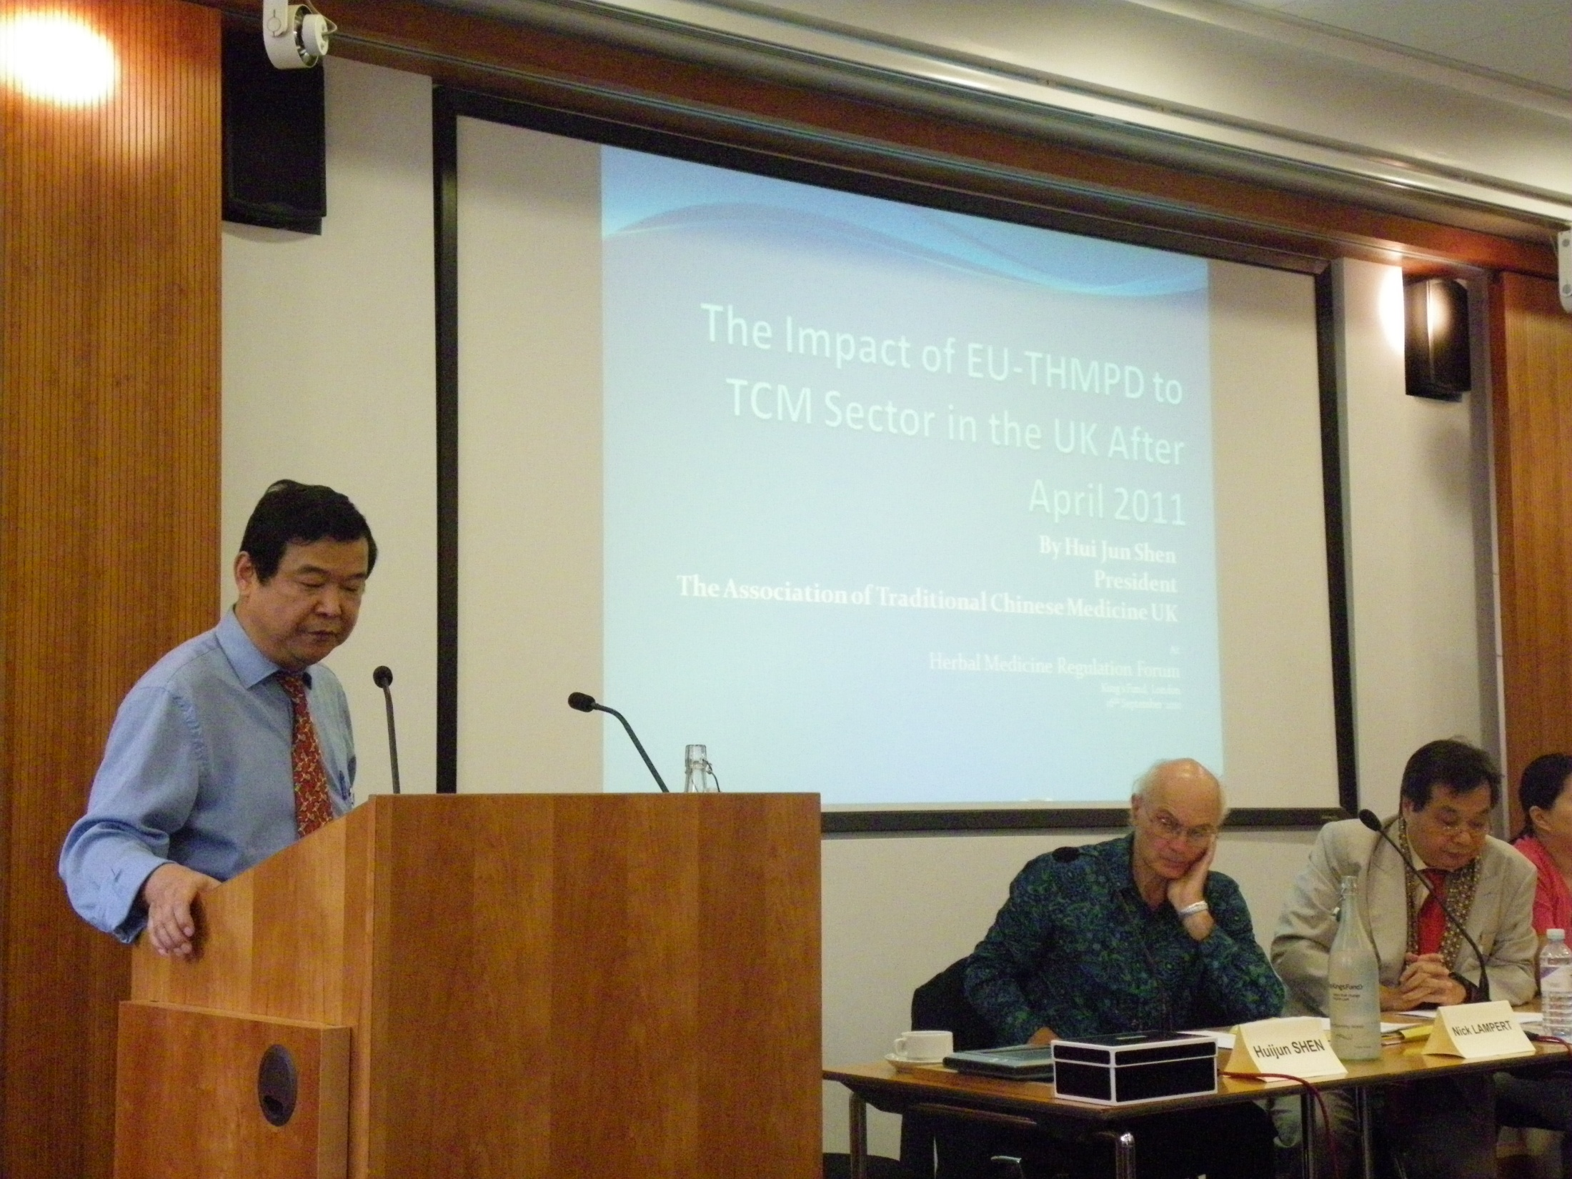

Slide 29
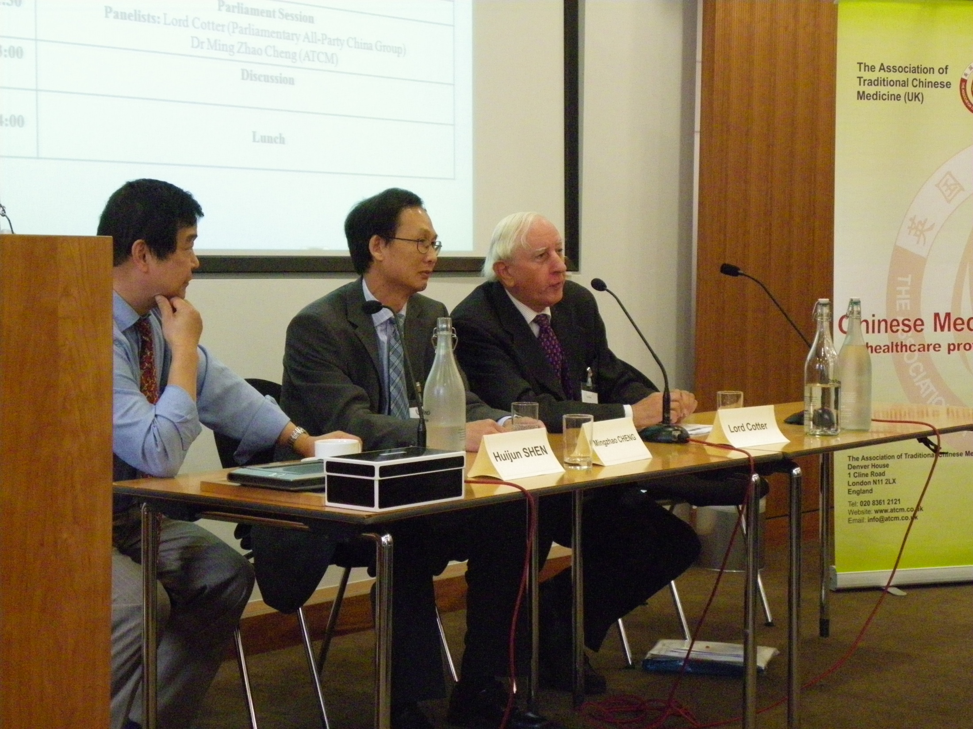

Slide 30


Slide 31


Slide 32


Slide 33
What should we do?
1. Practitioners regulation
No 1 Priority: Urge the government to keep on Statutory Regulation for HM and TCM practitioners.
With status of “authorized healthcare professionals”, practitioners will be able to commission wholesalers to prepare own products for individual patient needs.
Classic TCM products can be used as own products tailored to meet individual patient needs
Wholesalers will be able to continue trade on most TCM products, as well as dispensary services.
This is not only to protect the livelihood of practitioners, but also to protect wholesalers’ businesses.

Slide 34
Briefing letter to DH urging Statutory Regulation (SR)
Written by Mr Michael McIntyre, the chair EHTPA.
We advocate the professional organisations and wholesale businesses to jointly sign this letter to urge for practitioners’ SR.
THMPD fully implement in April 2011 means the end of HM/TCM products.
This is a real threat not only to the livelihood of practitioners, but also to the business of wholesale traders.
THR Scheme does not suit most of CHM products
Only very few (if any) CHM products would be THR registered by April 2011 and years after
SR is an immediate alternative to save the practice and business of HM/TCM sector.

Slide 35
What should we do?
2. THR
Dialogue with MHRA on problems with CHM products.
Look at the possibility to simplify THR for multiple-ingredient products, whereas no compromise to the quality and safety.
Chinese Pharmacopeia methods to determine key ingredients for such products may be adopted.
Wholesalers should apply for THR as soon as possible.
Co-ordination among wholesalers on what products should go for THR. Repeated application on the same products should be avoided.

Slide 36
What should we do?
3. The Directive
It may not be a right time and right place to challenge the Directive.
Still, we can ask if the Directive can be amended/postponed/stopped?
Any changes to the Directive do not seem to be imminent, but necessary in long term?
Can Chinese authority play a role here, for example, use WTO?

Slide 37
Questions to MHRA
It is almost certain that by April 2011 or even years after, there will be very few Chinese herbal medicine (CHM) products to get THR registered. We believe that the major hinder is the fact of multiple ingredients in most CHM products. Did the Directive and the THR scheme take this fact into the consideration at the first place? If not, can anything be done to offset this problem?
Is MHRA able to simplify the THR Scheme to make it easier for multiple-ingredient products, while no compromise to the quality and safety?
If the amendment of the Directive is necessary to solve the above problem, is MHRA able and willing to propose such legislative amendment to give multiple-ingredient products an equal opportunity for THR and/or licence? If MHRA is not able or willing to do so, who should we speak to?
Regarding the difficulty for multiple-ingredient products to register THR, MHRA and HMAC have advised the TCM sector to reduce the number of ingredients from the products. This is not imaginable to us as the products are normally classic formulae that have been used for centuries. Reducing ingredients will make them no longer the same products and both practitioners and patients will not easily accept them, not mention the uncertainty of efficacy and quality etc. Can MHRA give us some other advice to make it less problematic for multiple-ingredient products?

Slide 38
Questions to MHRA
5. One opinion says that THR is not appropriate to CHM products because of multiple-ingredient nature; the use of CHM products requires supervision and expertise advice, etc. Do you think that TCM sector should look at an alternative, rather than THR itself? What is the alternative in your opinion?
6. Article 5.1 of the Directive allows commissioning of manufactured unlicensed HM products by the authorised healthcare professionals to meet individual patient needs. However, in Question 22 of MHRA’s newly updated Guidance on Transitional Arrangements for the Directive of Traditional Herbal Medicinal Products, it states that “manufactured herbal medicines commissioned by herbal practitioners come with the scope of Directive and therefore require an MA or THR. Does the status of “authorised healthcare professionals” count for MA (medicines authorisation)? If not, is Art 5.1 arrangement still on offer?
7. The Point 3 of Answer to Question 22 in MHRA’s new guidance is rather confusing, could you please explain the meaning of point 3?
8. As for certain in years to come, most CHM products will not be able to get THR registered, Art 5.1 arrangement is crucial to TCM practitioners. Has MHRA explained this situation to the Department of Health and urged DH to keep on statutory regulation for practitioners. If not yet, is MHRA willing to do so as soon as possible?

Slide 39
Questions to MHRA
9. As we believe that a proper practitioners regulation offering us status of “authorised healthcare professionals” is likely to take place prior to April 2011, has MHRA started any preparation procedure for special Article 5.1 arrangement to allow the registered practitioners to commission unlicensed HM products to meet individual patient needs? If not, how soon will MHRA start this procedure? Can Article 5,1 arrangement be on offer in time?
10. In case the TCM and HM practitioners can obtain the status as “authorised healthcare professionals” by April 2011, can the commissioning of unlicensed HM products be made through the well-established professional organisations collectively, so all members of such organisations can use such unlicensed HM products in their own practice, or it has to be through the practitioners individually? If “collective commissioning” is not allowed, why?
11. In terms of concentrated herbal powders, there are two forms of herbal powders: herbal formulae in powder form (ready for use by patients) and single herbal powders (for the practitioner to mix up to form a herbal formula). According to Question 23 of the MHRA’s new guidance, is it right to say single herbal powders (as herbal extracts) count for ingredients so practitioners will be allowed to use them to make herbal formulae on premises under Section 12 (1) of Medicines Act 1968?
12. We have heard that some European countries such as the Netherlands have decided not to enforce the Directive after April 2011. Can you confirm that the EU member states have the right to postpone, or not to enforce at all, the Directive in their own country? Are EU member states allowed to postpone the full enforcement of EU Directive? If so, is UK authority willing to do so?

Slide 40
Questions to MHRA
13. We welcome a stricter regulation on herbal medicinal products. However, the new law seems to stop most industrial manufactured products but allow on site handmade products. Is this right in today’s highly advanced industrial time?
14. Some companies have submitted applications for some CHM products to get THR registered. But MHRA has not validated the applications for more than three months. How long does it normally take for MHRA to validate a THR application?
15. Some CHM products are for external use only, such as hair lotion, topic plasters or herbal cream. Do they have to be THR registered, or they can be registered as healthcare products?
16. Has MHRA established the quality standards for specific CHM products, say Liu Wei Di Huang Wan, what chemical components and their quantity to look at? If MHRA has not such standards ready to use in examining the application, should applicants provide own quality standards and how can applicants be sure that such self-provided standards would be accepted by MHRA?

Slide 41
Worst Scenario – What if……
If no CHM being granted THR
If no SR for TCM/HM practitioners
This means any manufactured CHM products will vanish in the UK
However, practitioners are allowed to make own products (Section 12(1) of Medicines Act 1968)
Single herbal powders as ingredients can be used for us to make herbal capsules
We will be able to make our own capsules based on classical formulae – Liu Wei Di Huang Capsules
Capsule fillers will be on demand
TCM is not going to die in the UK. Its life-force is efficacy, patient needs

Slide 42
Thank you and
Any Questions?
Although I may not be able to give answers

